Slide 1

DESIGN AND SIMULATION OF SENTINEL GUN ASSISTED BY IMAGE PROCESSING FOR DEFENCE APPLICATION
By
A. AJEETH (15UMEC103)
K. BARANIDHARAN (15UMEC102)
A. THERI MUTHU SELVAM (15UMEC050)
Guided by
Mr. R. SAKTHIVEL MURUGAN M.E.,(Ph.D)., (Asst.Prof/Mech)

Slide 2
INTRODUCTION
This prototype is going to develop for protecting the nation from the foreign terrorist entry through the border by shooting them by a self triggered gun attached in a multiple gun holder.

Slide 3
ABSTRACT
Every year our Indian soldiers have lost their lives due to sudden terrorist ingress and natural calamities. It should be a great lose to our nation. In order to save the life of our soldier, an autonomous guarding system is to be developed which should save the lives of the soldiers. In this project, a versatile gun holder and automatic aiming sentinel gun is designed with the assistance of image processing technology. Web Camera is used along with the gun holder to capture the live videos. This video is then further analysed for face detection and tracking. Precise coding is made for face detection and tracking algorithms using OpenCV, Spyder software. The output of face detection and tracking of the captured image sequences is then fed to Arduino microcontroller. In Arduino, the face tracking is coupled with the servo motors which directly controls the Gun for tilting, rotation and triggering. Thus, it could fire the enemies automatically when they come into the range of the camera. This work will be useful for our country in Défense Sectors.

Slide 4
PROJECT OBJECTIVE
To avoid the soldiers suffering from over hotness and coldness due to winter and summer season.
To reduce the monitoring work of the soldier from morning to night.
To shoot an enemy if he cross the border when soldier is not there.
To reduce the death of border guard soldiers.
To guard the border 24×7.
To manage the sudden terrorist ingress.
To avoid the periodic alteration of soldiers from borders.
To trigger the gun automatically.

Slide 5
PROBLEM IDENTIFICATION
Periodic soldiers death
Guarding in unsafe environment
24×7 monitoring without sleep
Natural calamities
Soldiers fell in sick while guarding
Sudden terrorist attack

Slide 6
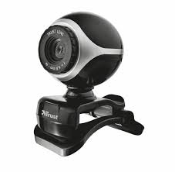


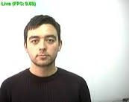
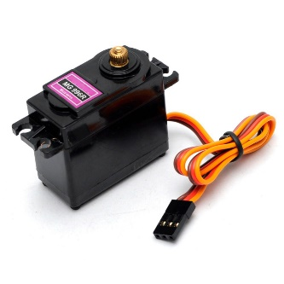
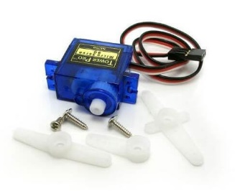
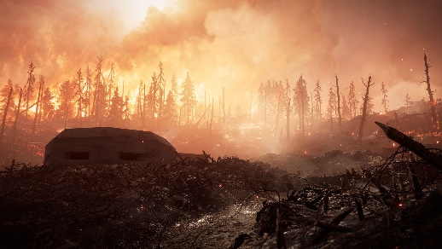
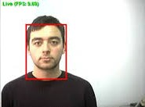

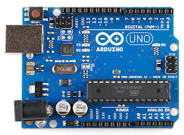
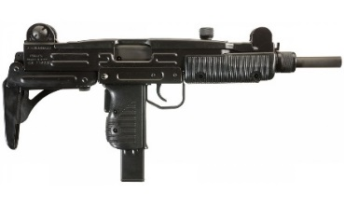
METHODOLOGY
Face Detection Coding
Face Recognition
Input-Video Capturing
Battle Field
Triggering
Rotation
UZI
Output of Spyder
Tilt Up and Down
Arduino Controlling

Slide 7
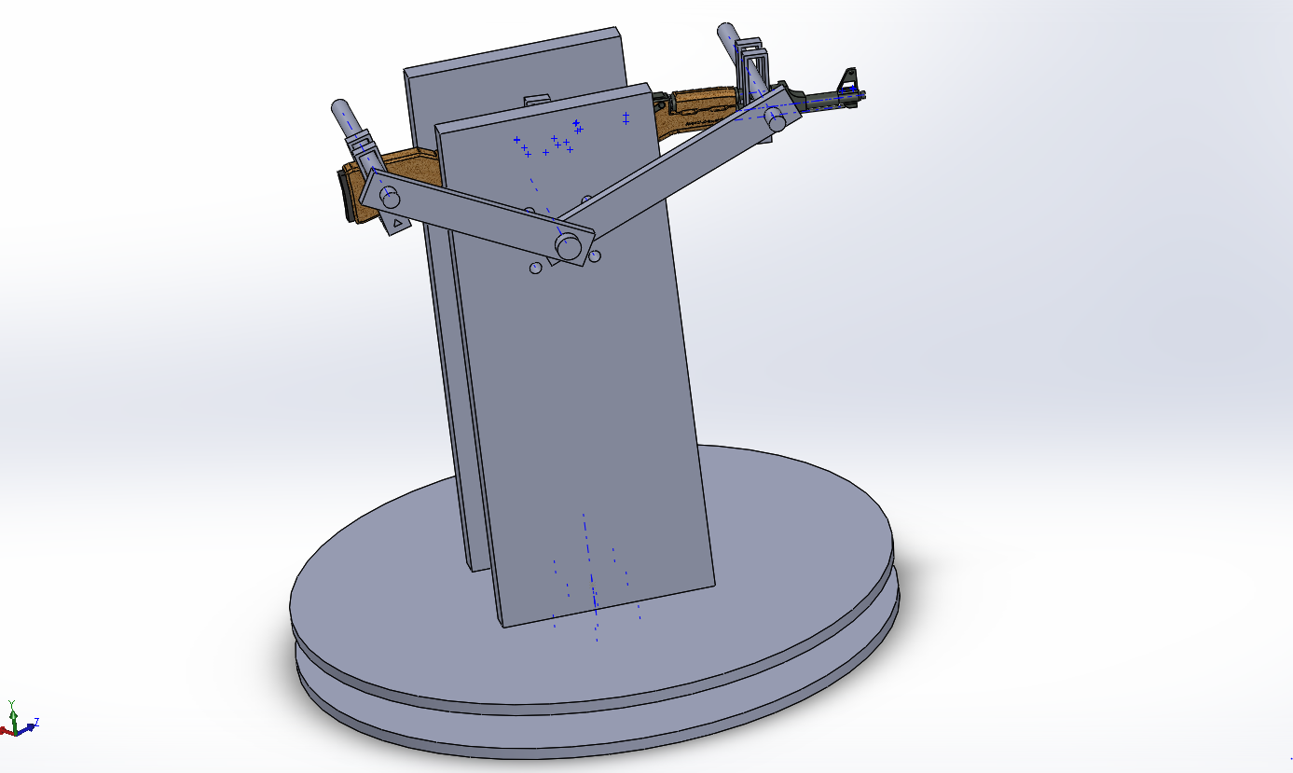
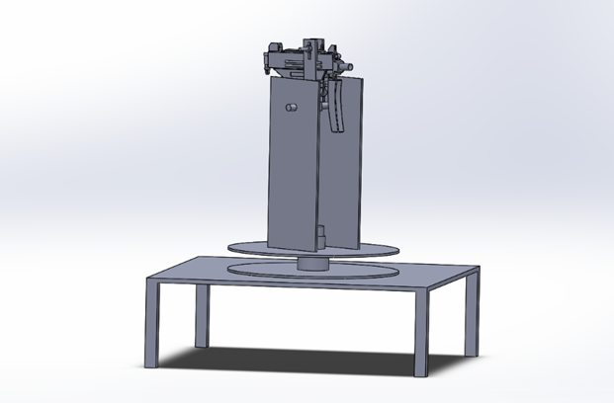
GUN HOLDER DESIGN
Exact Design
Prototype Design

Slide 8
DESIGN CALCULATION
Calculation for Selection of Servo Motor
Mass of the base plate = 0.250kg
Mass of the gun = 0.380kg
Mass of the right leg = 0.050kg
Mass of the left leg = 0.050kg
Mass of the nylon rod = 0.10kg
Acceleration due to gravity (a) = 9.81m/s^2
Radius of the circular disk (r) = 10.5cm
Total mass = Mass of the base plate + Mass of the gun + Mass of the right leg+
Mass of the left leg + Mass of the nylon rod

Slide 9
DESIGN CALCULATION
Total mass = .250 + .380 + .050 + .050 + 0.10 = 0.83kg
Force = Total mass × Acceleration
= 0.83 × 9.81 = 8.1423 N
Torque = Force × Radius
= 8.1423 × 10.5 = 85.4941 N-cm
In terms of torque in kg-cm
Torque = mass × radius
= 0.83 × 10.5 = 8.715 kg-cm
In order to rotate a weight of .83kg kg, a servo motor of 10 kg-cm is selected

Slide 10
MATERIALS REQUIRED FOR PROTOTYPE
Acrylic sheet
Nylon rod
12v 100 RPM dc motor
Stepper motor
Arduino UNO
L293d drive
Jumper wires
Webcam
Data cable

Slide 11
IMAGE PROCESSING TECHNOLOGY
Image processing is an technique in which the input is an image or a series of images or videos, such as photographs or frames of video. The output of image processing can be either an image or a set of characteristics or parameters related to the image.
It also means "Analyzing and manipulating images with a computer". Image processing is performed this three steps
First, import images with an optical devices like a scanner or a camera or directly through digital processing.
Second, manipulate or analyze the images in some way. This step can include image improvement and data summary, or the images are analyzed to find rules that aren't seen by the human eyes. For example, meteorologists use this processing to analyze satellite photographs.
Last, output the result of image processing. The result might be the image changed by some way or it might be a report based on analysis or result of the images.

Slide 12
SOFTWARE USED
Design
Solidworks
Image Processing
Anaconda
Spyder
Platform
Opencv
Arduino

Slide 13
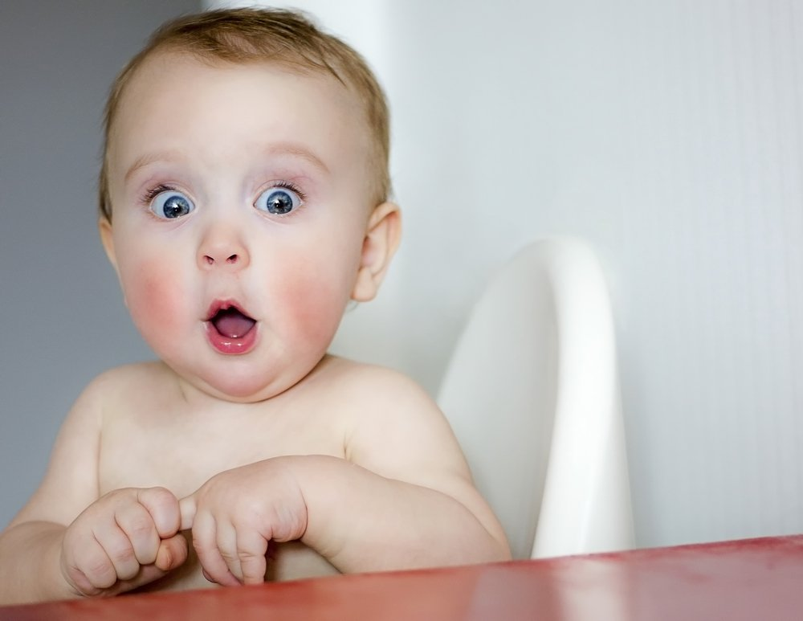
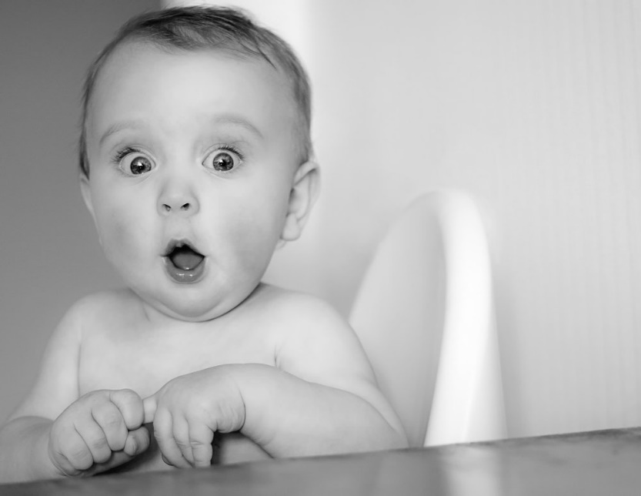
Coding
Original Image Program
Grey Image Program
Original Colour Video Program
Grey Coloured Video Program
Face Detection Program
Arduino Coding
Video
baby.jpg
Babygray.png

Slide 14
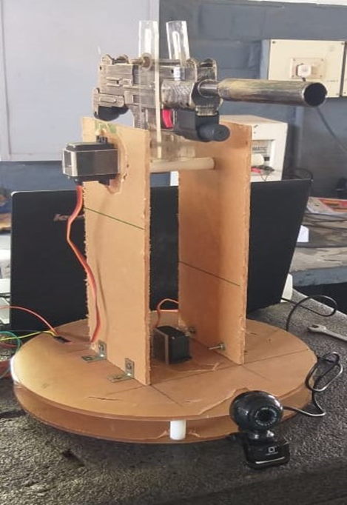
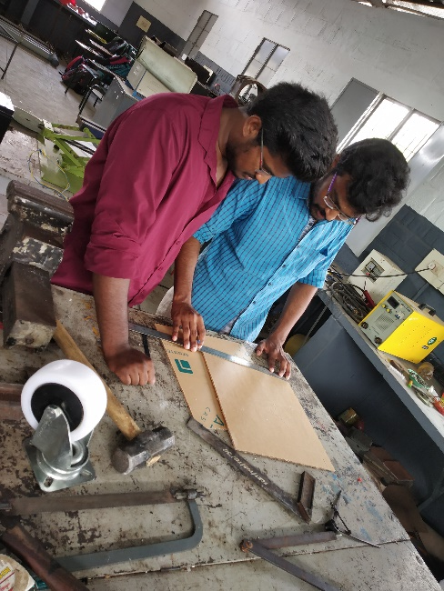
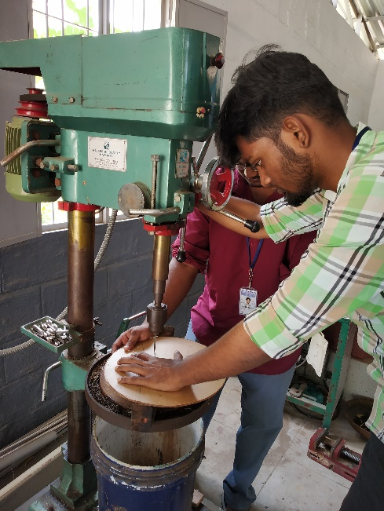
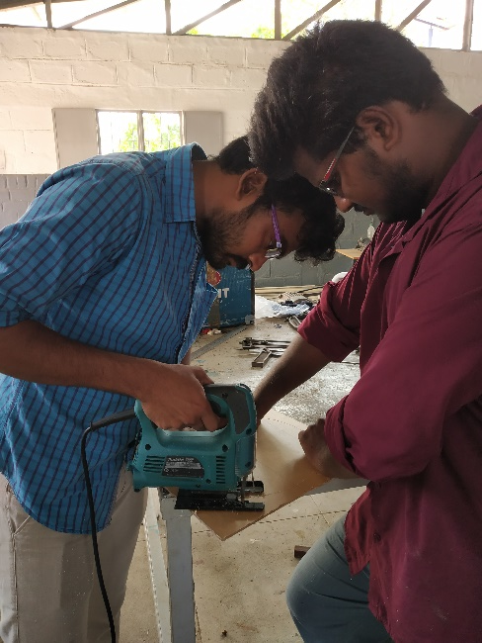
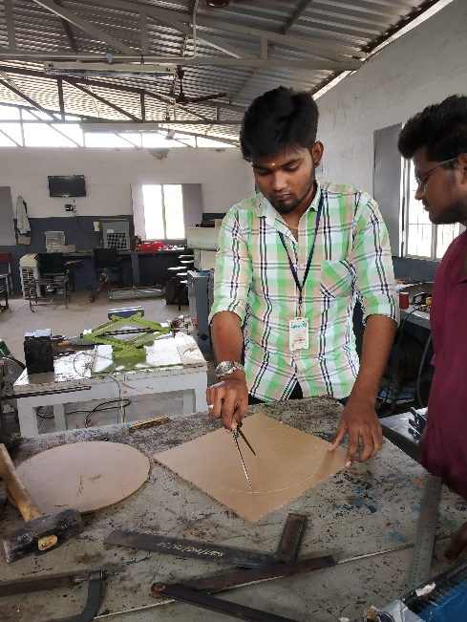
FABRICATED MODEL

Slide 15
CONCLUSION
The theme of the work is to design a versatile gun holder and automatic aiming sentinel gun. To achieve this, image processing technology is applied and integrated in the newly designed gun holder. Web Camera is used along with the gun holder to capture the images. It acquires the live videos which should be then further analysed for face detection and tracking. Precise coding is made for face detection and tracking algorithms. The captured video from the web camera is fed to spyder software where the coding is compiled in OpenCV platform. It gives the output of face detection and tracking of the captured image sequences and it is then fed to Arduino microcontroller. In Arduino, the face tracking is coupled with the servo motors which directly controls the Gun for tilting, rotation and triggering. Thus, it could fire the enemies automatically when they comes into the range of the camera.
This work will be useful for our country in Defence Sectors. It could save the Indian soldiers from natural calamities, sudden terrorist attacks and reduces guarding difficulties. In future, response rate of the face detection and firing accuracy will be improved by implementing high end DSLR camera and nanosecond controller. The sentinel gun will guard the borders of our nation with more reliability and with full safety.

Slide 16
FUTURE WORK
Microcontroller board will be replaced by Nano controller board.
Raspberry-pi will be used in future to increase the accuracy.
Prototype will be fabricated to exact design.
Web camera will replace by DSLR camera to increase the operating range.
The photographs and dress code of Indian army is feed in to the operating system to aim and fire only the terrorist or foreign military.

Slide 17
REFERENCE
Belaroussi.R, Milgram.M (2012), 'A comparative study on face detection and tracking algorithm', Expert systems With Application, Vol 39, pp7158-7164.
Bhattacharjee.A, Das.P (2015), 'A Real - Time Face Motion Based Approach towards Modelling Socially Assistive Wireless Robot Control with Voice Recognition', International Journal of Advanced Computer Science and Application, Vol 6, Issue 10, pp 205-219.
Faux.F, Luther.F (2012), 'Theory of evidence for face detection and tracking', International Journals of Approximate Reasoning, Vol 53, Issue 5, pp 728-746.
Hjelmas.E, Low.B.K (2001), ' Face Detection: A Survey ', Computer Vision and Image Understanding, Vol 83, pp 236-274.
Kalas.M (2014), 'REAL TIME FACE DETECTION AND TRACKING USING OPENCV', International Journal of Soft Computing and Artificial Intelligence Vol 2, Issue1, pp 41-44.

Slide 18
Thank You

